Slide 1

Implementation of Staggered Projections for Frictional Contact in Multibody systems in card house
Authors: Danny M. Kaufman, etc.
Presenter: Lake Chen and Yuchen Luo

Slide 2
Outlines
Introduction
Previous Work
New Method
Important Equations
Test Case and analysis
Result and Discussion
Workload Distribution
Summary

Slide 3
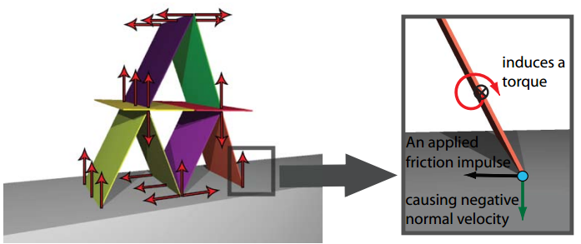
Introduction
Grand Challenges in rigid body simulation
Jitter free
Stacking of multiple objects
Friction Prediction
Friction Prediction is the topic
covered in this presentation

Slide 4
Previous Work
Penalty-based Method--- stiffness, stability issues
Linear Complementarity Programming (LCP)-based Approach
1) acceleration-level: NP-hard
2) velocity-level : non-convex
3) iterative LCP : errors, artifacts and lots of iterations
4) direct LCP : long computation time

Slide 5
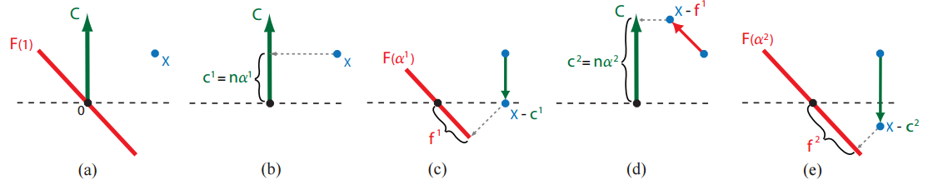
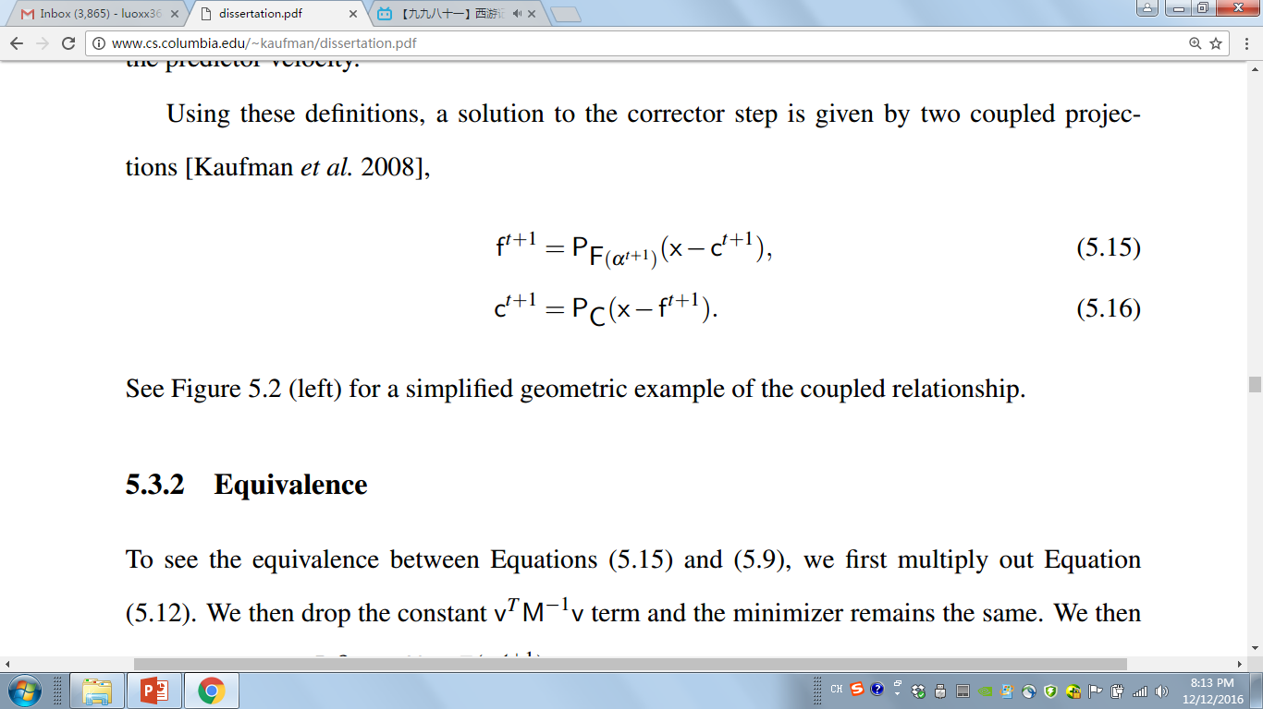
New Method--- Velocity-based Staggered Projection Method
Normal Direction
Friction Set
(a) Predicted Velocity:
X, without constrain
(b) Project the x-f⁰ to obtain normal impulse
(c) Project the x-c¹ on friction set and obtain f¹
(e) Project the x-f¹ to obtain normal impulse c²
(e) Project the x-c² on friction set and obtain f²

Slide 6
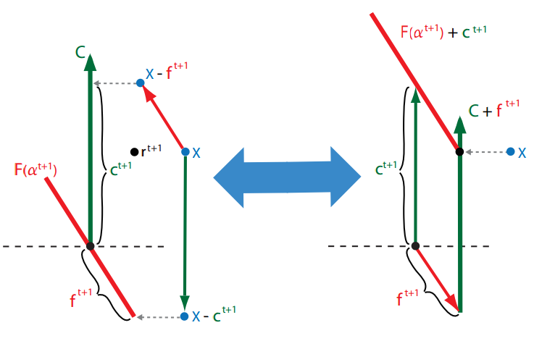
New Method(continue)--- Velocity-based Staggered Projection Method
Till converge

Slide 7
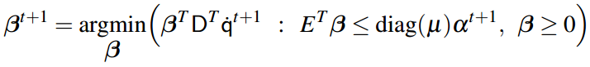
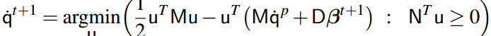
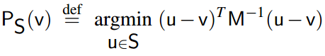
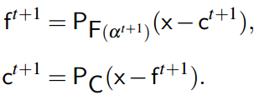
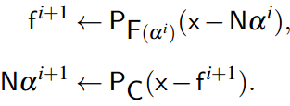
Important Equations
Friction:
Normal :

Slide 8
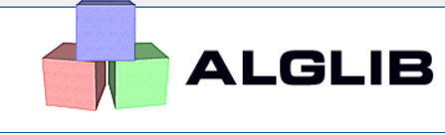
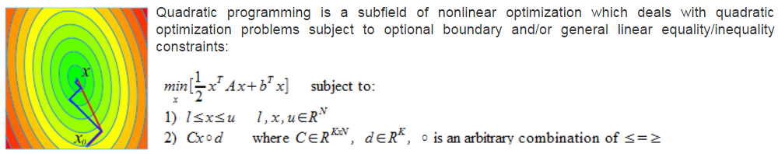
Important Equations(continue)--- Quadratic Programming
constrain
Target function

Slide 9
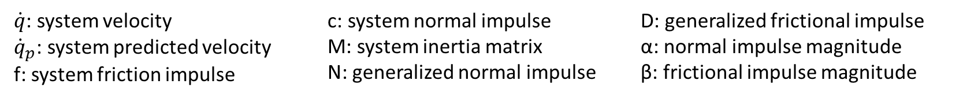
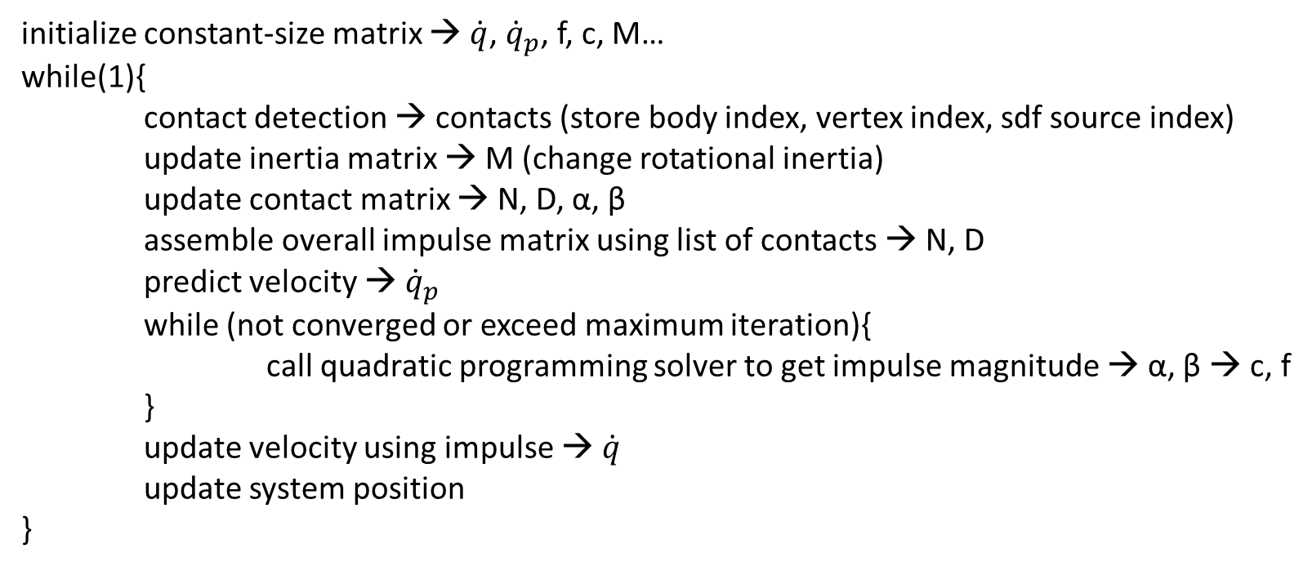
Framework Pseudocode
initialize constant-size matrix → $\dot{q}$, ${\dot{q}}_{p}$, f, c, M…
while(1){
contact detection → contacts (store body index, vertex index, sdf source index)
update inertia matrix → M (change rotational inertia)
update contact matrix → N, D, α, β
assemble overall impulse matrix using list of contacts → N, D
predict velocity → ${\dot{q}}_{p}$
while (not converged or exceed maximum iteration){
call quadratic programming solver to get impulse magnitude → α, β → c, f
}
update velocity using impulse → $\dot{q}$
update system position
}
$\dot{q}$: system velocity
${\dot{q}}_{p}$: system predicted velocity
f: system friction impulse
c: system normal impulse
M: system inertia matrix
N: generalized normal impulse
D: generalized frictional impulse
α: normal impulse magnitude
β: frictional impulse magnitude

Slide 10
Test Case
Collision Detection and Response
Normal Impulse
Frictional Impulse
Stacking
Card House with No Friction
Card House with Friction

Slide 11
Workload Distribution
Equation Derivation(Yuchen and Lake)
Quadratic Programming (Yuchen)
Code framework (Lake)
Debug and test cases (Yuchen and Lake)
Slides (Yuchen and lake)
Post Processing Animation (Lake)
Present (Yuchen and Lake)

Slide 12
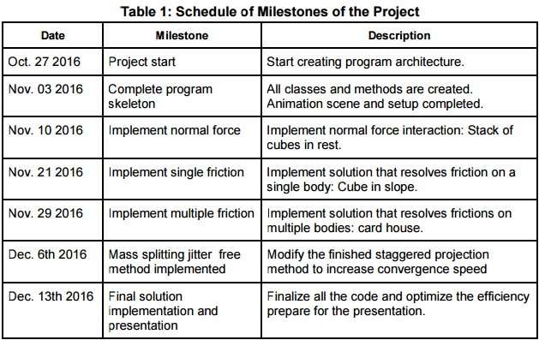
Summary

